Slide 1
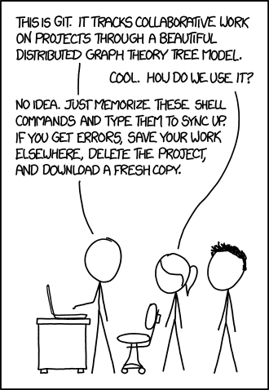
Git Source Control
March, 2021
Notes:
Mention you need to install git for command line | Get volunteers

Slide 2
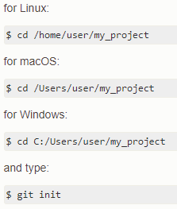
Getting a Git Repository
You can take a local directory that is currently not under version control, and turn it into a Git repository, or you can clone an existing Git repository from elsewhere.
This image details initializing a repository in an existing directory.

Slide 3
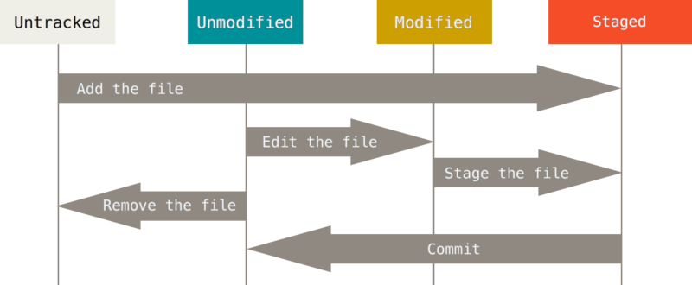
Recording Changes to the Repository

Slide 4

Adding Files
Once your project has a repository, you can start adding files.
These commands add the following files, and then commit them to “Initial project version”:
-Files ending in .c
-The file called LICENSE

Slide 5
Cloning an Existing Repository
What most of us are probably used to is cloning a GitHub (or other) repository.
This command clones the repository linked into the directory “mylibgit”.
Without the final argument, the directory would just be titled “libgit2”.

Slide 6
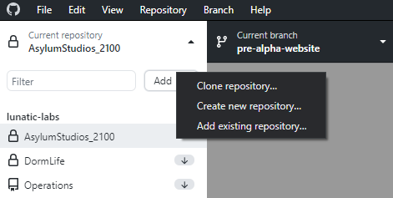
Adding a Repository on GitHub Desktop
Simply Clone, Add, or Create a new repository in GitHub desktop.
You can even publish repositories on your computer to GitHub.
Notes:
3 files in repo
-one staged (add, don’t commit)
-one untracked (don’t add)
-one unmodified (add and commit)
-one modified (add, commit, change)

Slide 7

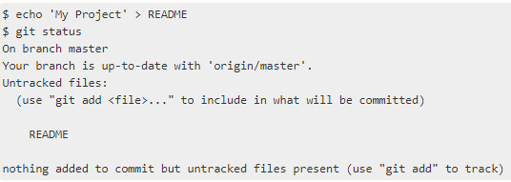
Checking the Status of your Files
None of your tracked files are modified, and git did not see any untracked files.
You have created a README file that is untracked, meaning it was not seen in the last commit.

Slide 8

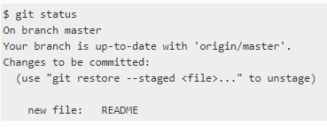
Tracking New Files
Your README file is now staged.

Slide 9
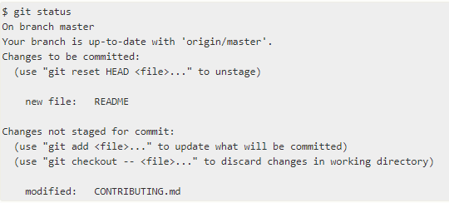
Staging Modified Files
If you change a previously tracked file, such as CONTRIBUTING.md in this example, your git status command will look similar to this:
Make sure to “git add” this file to stage it!

Slide 10

Ignoring Files
.gitignore contains information about files you don’t want git to automatically add or show you as being untracked.
This file tells git to ignore files ending in .o or .a, and also files ending in ~.

Slide 11
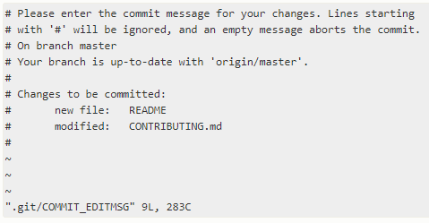
Committing Your Changes
Simply type ‘git commit’ with no other arguments, and your default editor will launch and display the following text:
Type in the summary of your commits, and enter to close. Your changes have now been committed!
Notes:
You can also do git commit -m “commit message”

Slide 12
Removing Files
Viewing Commit History
Simply removing the file from the directory is a change that is not staged.
Running ‘git rm FILENAME.md’ stages the file’s removal.
‘git log’ lists the commits made in that repository in reverse chronological order.
There are a huge number of options to the git log command, too many to cover here.

Slide 13

Un-modifying a Modified File
Using ‘git status’ shows the modified files. It also details how to unmodify it.
git checkout -- CONTRIBUTING.md
Notes:
-clone repo “git clone https://github.com/Lunatic-Labs/LL-Ops-Testing testing”
-create 2 test text files “test1.txt” “test2.txt”
-add file “test1.txt”
-keep one untracked “test2.txt”
-change README.md
-check status - Untracked: test2.txt, Unmodified: LICENSE, Modified: README.md, Staged: test1.txt
-echo > test.obj
-create an .obj to the folder
-check status, note .gitignore does not see it as untracked
-remove a file
-check status
-use git rm filename
-commit
-view commit history
-change README again
-git status
-git checkout --README.md
-git status to see changed have been removed

Slide 14
Stashing
A way to save current work that you don’t want to fully commit
Think of it as a “storage bin” (i.e. a “stash”) of various files
Files may or may not be useful
Unlike committing, you don’t have to decide what is useful
git stash save & git stash push -- two alternatives
Or just git stash (will do “save” by default)
“push” will stash arbitrary paths/directory trees

Slide 15
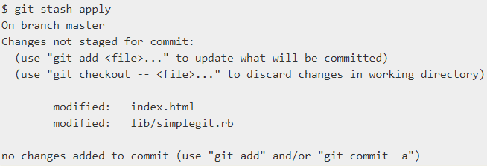




Stashing - cont.
You can then switch branches and test features
Use “apply” to re-add your stashed work
Basic stashing example w/ dirty directory tree
Note that it will stash both staged and unstaged work
Use “list” to see your stashes
You can apply different stashes
git stash apply stash@{2}

Slide 16
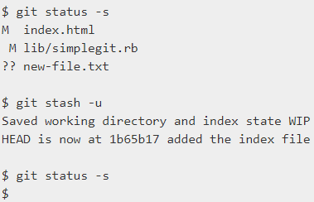

Stashing - cont.
Drop
stash -u / -a
Push / Pop
Applying doesn’t remove it from the stash list.
Use drop to do that.
--include-untracked | -u
Will also stash untracked
git stash push
Like “save” but with a pathspec
git stash pop
Applies and drops in one step
--all | -a
stash untracked & ignored

Slide 17
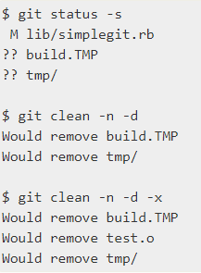
Cleaning
Removes cruft, build artifacts, backup files, etc
Permanently deletes files
Be absolutely sure before you do this

Slide 18
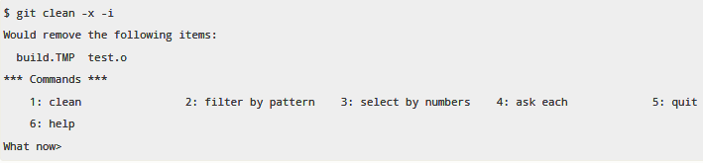
Cleaning - cont: Flags
-d -> removes directories
-n -> dry-run
-i -> interactive
-f -> force/actually do this
needed unless clean.requireForce is set to false
-x -> remove ignored files
For a pristine, cruft-free directory tree, with no untracked or ignored files use:
git clean -dfx
Notes:
-Clone testing repository into a folder called testing
git clone https://github.com/Lunatic-Labs/LL-Ops-Testing testing
-We want to see all types of files
-Create 2 text files - test1.txt, test2.txt
-Make one staged for commit
git add test1.txt
-Keep test2.txt untracked
-Change README.md to create a modified file
git status
-Untracked: test2.txt, Modified: README.md, Staged: test1.txt, Unmodified: the rest of the files in the folder.E
-Create an .obj file
echo > test.obj
-We assume it will show up as untracked, however it does not. This is because the .gitignore file has ignored .obj files
-We will commit the change we have
git commit -m “Created test1.txt”
-We will now remove the test1 file
-Check status, test1 is deleted but not staged for committing
-Stage removal for commit
git rm test1.txt
-Commit the change
git commit -m “Removed test1.txt”
-Check status, notice README.md is still modified
git status
-Remove changes from README.md
git checkout -- README.md
-Check status again to see that the changes have been removed
git status
-View commit history
git log

Slide 19

Tagging
Git has the ability to tag specific points in a repository’s history as being important. Typically, people use this functionality to mark release points
git tag: lists all tags in the repo

Slide 20

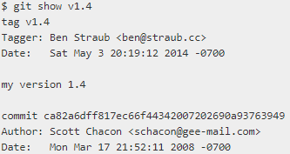
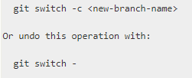
Tagging - cont.
Create
Share / Remove
Checkout
Annotated or Lightweight
Share:
Remove:
Detached Head (commits don't take effect unless you switch to a new branch)

Slide 21
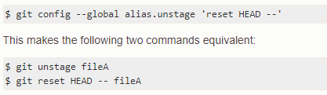
Aliases
Creates shorthand commands

Slide 22
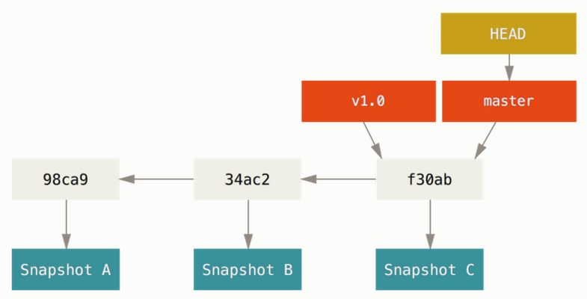
Branching
Git works by storing commits, or snapshots of what the project contains.
Each commit points to the previous commit to show the history of the repository.
A branch is simply a pointer to a commit
There is also a head pointer that points to branch pointers. The head pointer always points to the branch that you are currently ‘checking out’
On initialization git creates a branch named ‘master’ while you can rename the branch it is not recommended to do so if you have other programs referencing it. (Many do)
Above you can see an example of what a repository looks like after creating a branch. Each commit is pointing to it’s previous version and both branches are pointing to the same commit as no new commit has been created. Head is pointing to master as that is what we are currently ‘checking-out’
Notes:
Explain how git uses commits and how branches point to commits

Slide 23
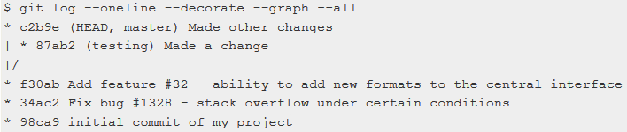
Branching Command line
To create a new branch called ‘testing’
To switch to a branch called ‘testing’
Checking the log will show the commit history as well as mark where the branches are. The one with head is the branch you are currently checking out
Notes:
Explain how to move between branches

Slide 24
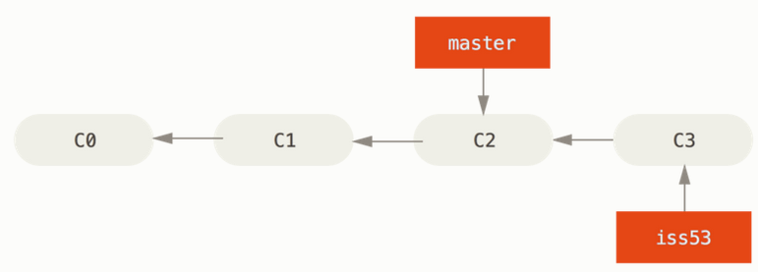
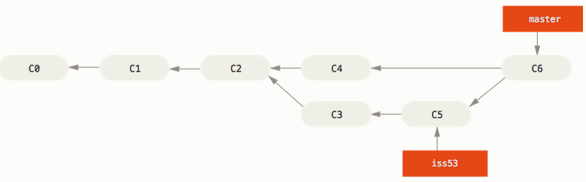
Branching and Merging
When you commit on a new branch another commit will be created no differently than before. If the master branch has no commits made then merging the two branches is as simple as moving the master branch pointer to the same commit as the new branch.
If commits have been made on both of the branches then the commit history will begin to look like a branching tree. As seen in the bottom picture both c4 and c3 point to c2 as that is the last commit both claim ancestry from.
If two branches are merged and both have commits as seen in the bottom image then git will take the common ancestor as well as the two commits and try to merge them. The new commit resulting from the merge will point to both commits.
The above picture is what happens after iss53 is merged into master while master was at c4
Notes:
Explain how merging works

Slide 25

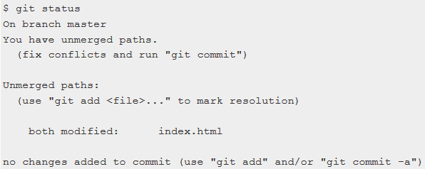
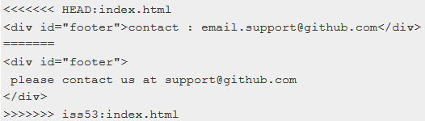
Merging
In order to merge checkout the branch you want to be merged into (such as master)
Merging can be done by running ‘git merge <branch you want to merge>’
If there is a conflict in the merge it will inform you but you will need to run ‘git status’ to see a more detailed report.
In your code you will see the two different variants of the code that you can choose from. Delete one version and keep the other, or change it to something else.
You can use ‘git mergetool’ to open up a mergetool if you have one installed.

Slide 26
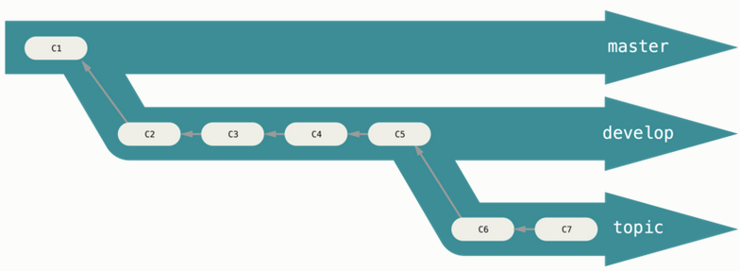
Branch Workflows
Because of Git’s versatility with creating and destroying branches with ease it is considered best practice to keep three different types of branches.
Master Branch - Everything that is pushed on here has been heavily tested and often consists of what is currently available to the consumer
Development Branch - Everything that is pushed here functions but needs testing or is up for review by project managers
Topic Branch - This is the Wild West branch, things will be broke. These are areas to try new things without affecting the rest of development.

Slide 27
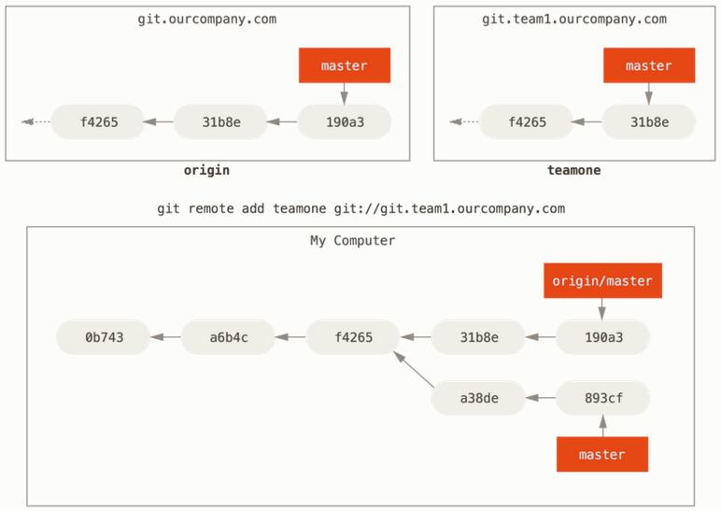
Remote Branches
When working with a remote service, such as GitHub, your local machine may not be up-to-date with the repository.
Will retrieve all of the commits that you’re local computer does not have but will not merge it with your local repository.
Is the same as fetch but will merge your local repository with the changes from the server.

Slide 28
Rebasing
An alternative approach to integrating your changes that creates a cleaner history with a linear log of integrations.

Slide 29
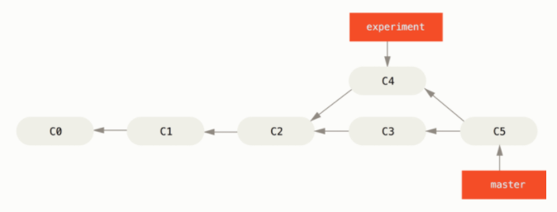

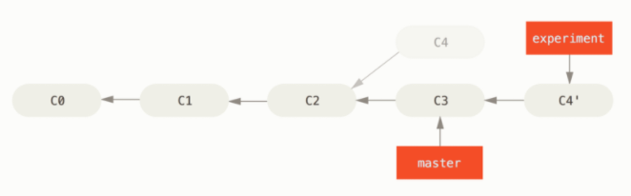
Rebasing-cont.
Merge:
Command
Rebase:

Slide 30
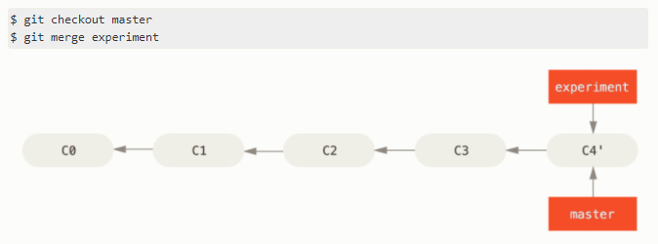
Rebasing-cont.

Slide 31
Instructional Video Source
https://drive.google.com/file/d/1TfxCylYLbr6_7l1-PNd_JMYuI4tFkEGv/view?usp=sharing

